Slide 1
Grade 9 Math PAT/Final Review
2017

Slide 2
Composite Surface Area
Perfect/Imperfect Squares
Benchmarking
Using perfect squares to estimate roots
Pythagoras
Composite Surface Area
Find the surface area of all shapes and subtract the overlap x 2

Slide 3
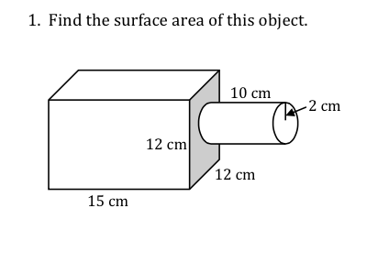
Notes:
Surface Area of Rectangular Prism
Front, Back, Top, Bottom = 4 (12 × 15) = 720 cm2 Left, Right = 2 ( 12 × 12 ) = 288 cm2 Total : 1008 cm2
Surface Area of Cylinder
Top, Bottom = 2 × Area of circle = 2 (π r2) = 2 × π × 22 = 25.12 cm2
Curved Surface=2πr×h = 2×π×2×10 = 125.6 cm2 Total: 150.72 cm2
Area of Overlap
Area of a Circle ....don`t forget to double it! 2 × Area of circle = 2 (π r2) = 2 × π × 22 = 25.12 cm2
Total Surface Area of the Composite Object
SA of rectangular prism + SA of cylinder – area of overlap
1008 + 150.72 – 25.12 = 1133.6 cm2

Slide 4
Exponent
Power/Base/Exponent
Brackets and exponents
Scientific notation
Exponents of 1 and 0
Order of operations
BEDMAS
Exponent Laws

Slide 5
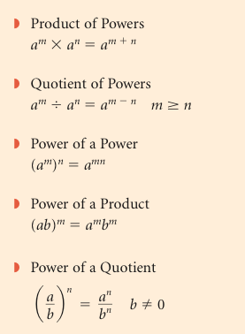
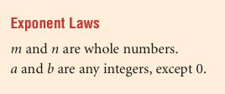
Exponents

Slide 6
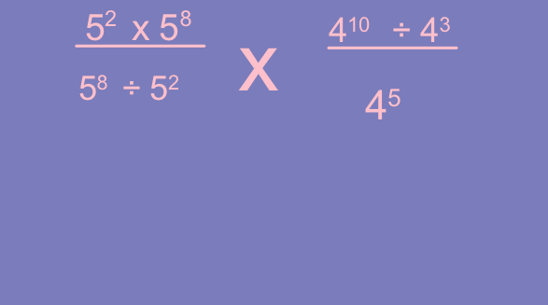
Exponents

Slide 7
Working with Fractions
Terminology
Adding/Subtracting
Multiplying
Dividing
Mixed/Improper
Reducing
Remembering Order of Operations

Slide 8
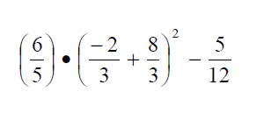
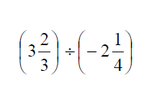
Fractions

Slide 9
Rational Numbers
Terminology (Rational number = Q)
m/n where n is not 0
include all integers, fractions, terminating decimals and repeating decimals
Using number lines and ordering numbers
Will get your calculator
+/- rules

Slide 10
Rational Numbers

Slide 11
Polynomials
Terminology
Terms, coefficient, variable, constant, degree
Monomial, binomial, trinomial
Ordering from highest to lowest
Using algebra tiles
Like terms
Simplifying polynomials
Adding, subtracting!, multiplying and dividing

Slide 12
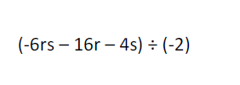
Notes:
There is only 1 MAJOR difference: when you drop the brackets you change the sign of each term after the subtraction sign

Slide 13
Linear Relations
Tables of values and patterns
Independent/Dependant Variable
X/Y axis and Cartesian Coordinates
Continuous and Discrete Data
Equations for a line (H/V/O)
Matching graphs to equations (and v.v.)
Extrapolation/Interpolation

Slide 14
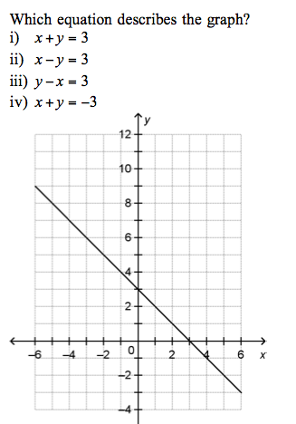

Slide 15
Linear Equations & Inequalities
Inverse Operations
Reverse order of Operations
Inequalities
Multiplying/dividing by negative (reverse)
Graphing inequalities
Word Problems
Notes:
Step 1 – define your variables T = Tights
Step 2 – Find keywords for inequality (maximum, minimum, more than, at least….
Step 3 – Find keywords for operation “$20.00 eac, initial cost
Step 4 – Write the inequality 20t + 250 ≤ 500

Slide 16
Linear Equations and Inequalities
Solve and Graph
-2(3-1.5n) < 3(2-n)

Slide 17
Similarity and Symmetry
Scale Factor
Similarity and proportionality
SF <1 or SF >1
Units
Reflections, Rotations, Translation
Describing line symmetry
Describing rotational symmetry (order and angle)

Slide 18
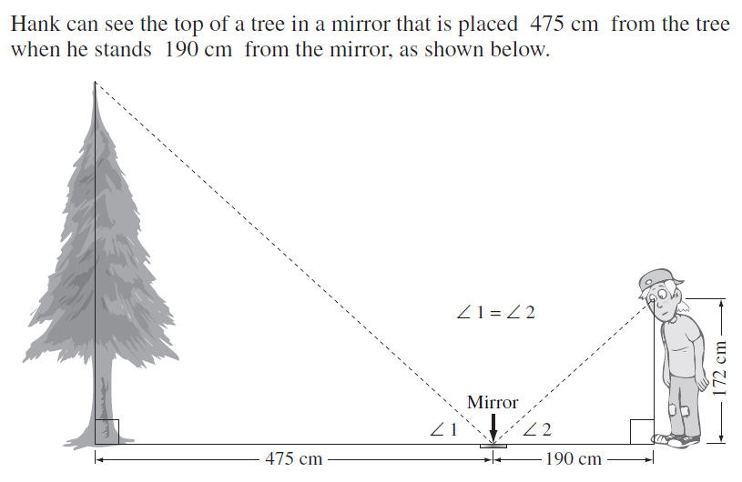
Similarity and Symmetry
Notes:
430 cm

Slide 19
Circle Geometry
Angle Sum Theory and Pythagorus
Circle Geometry Properties
Tangent
Chord (x3)
Angles (x3)
Solving puzzles

Slide 20
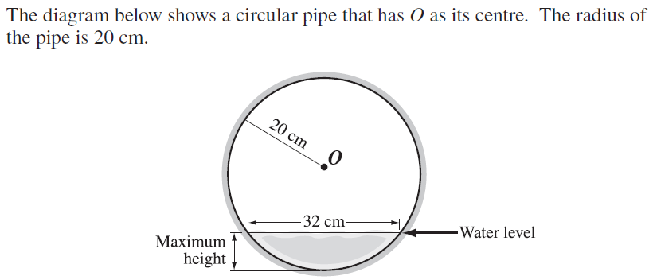
Circle Geometry
Notes:
8cm

