Slide 1
Science 9 PAT Review

Slide 2
PAT Rules Overview
Come Prepared - Pencil, Eraser & Calculator, book for after you are done
You may bring WATER in a bottle
NO CELL PHONES – (obviously).

Slide 3
Test Format
55 Selected Response Questions
- 50 Multiple Choice
- 5 Numerical Response
11 questions for each of the 5 units:
Biological Diversity
Matter and Chemical Change
Environmental Chemistry
Electrical Principles and Technology
Space Exploration

Slide 4
Overall Hints
Skill Testing Questions- Literally
Most questions will have a set of data, diagram, graph or table with information for you to interpret
You will get a modified periodic table and some formulae (Ohms Law)
Ask Questions - if you are not sure if I can answer - ask anyway, I will let you know!

Slide 5
Scientific Method Review
Manipulated Variable - Changed by the experimenter
Responding Variable - Result of the change. Can be measured quantitatively or described qualitatively.
Controlled Variables - Other variables that MUST be kept the same so the experiment is valid and reliable. This makes the test FAIR.

Slide 6
Practice!
Susie wants to know if electrochemical cells will vary if she changes the type of electrodes. She sets up four cells:
- two copper electrodes
- one Zn, one Cu
- one Al, one Cu
- one Pb, one Cu
Notes:
What is the Manipulated Variable?
What could be the Responding Variable?
What should be controlled to make the experiment FAIR?

Slide 7
Biological Diversity Review!
Main Concepts:
- Diversity and Variation - importance, location, continuous vs discrete
- Niches, Generalists/Specialists, Symbiosis, Adaptations
- Reproduction (Sexual/Asexual), Meiosis, Pollination, Fertilization, Mitosis, stages in sexual reproduction and development.
- Genetic Variation - DNA Structure, Dominance/Recessive, inherited traits chromosome numbers
- Artificial vs Natural Selection
- Extinction, extirpation, endangered
- Conservation - zoos, national parks, seed banks, treaties

Slide 8
PAT Sample Questions
Let’s look at some of the PAT SAMPLE QUESTIONS together

Slide 16
Matter and Chemical Change Review!
Main Concepts:
- Properties: Physical (Qualitative vs Quantitative) & Chemical
- Changes - Physical and Chemical (what are the indicators of each)
- Pure Substances vs Mixtures
- Atoms vs Ions
- Metals vs Nonmetals - know how to use your periodic table!
- Chemical Compounds - know your common ones (salt, methane, sugar, carbon dioxide)
- Molecular vs Ionic compounds - formation & composition (use periodic table), naming, properties & structure (incl. Law of Definite Composition)
- Chemical reactions - Law of Conservation of Mass, Reaction Rate, Endothermic vs Exothermic

Slide 17
PAT Sample Questions
Let’s look at some of the PAT SAMPLE QUESTIONS together

Slide 25
Environmental Chemistry Review
Main concepts:
- nutrients and substrates: organic (proteins, carbs, lipids) vs inorganic, fertilizers (NPK)
- Ingestion vs absorption of materials
- Bioaccumulation vs Biomagnification
- Relationship between oxygen, nutrients (aka phosphates), organisms (including invertebrates)
- pH - how to measure, influences, causes of changes, how to neutralize
- Soil porosity
- Toxicity - acute vs chronic, LD50, ppm
- Bioremediation & Biodegredation
- Distribution, dilution, concentration

Slide 26
PAT Sample Questions
Let’s look at some of the PAT SAMPLE QUESTIONS together

Slide 28
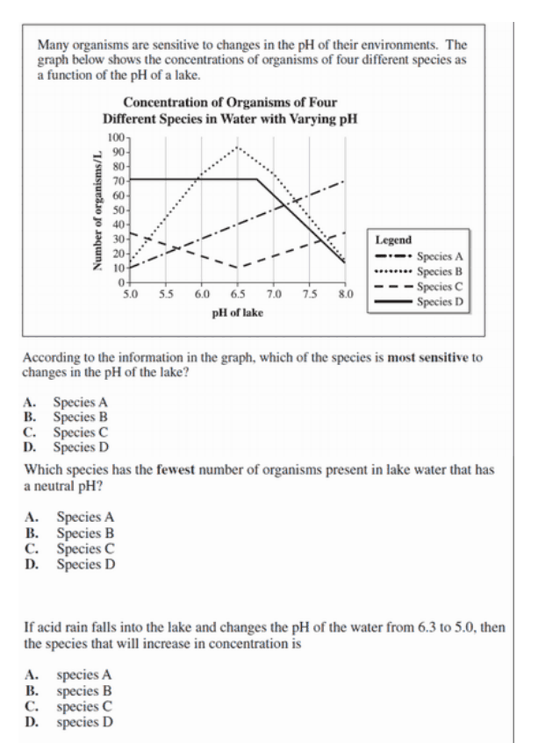

Slide 34
Electricity Review!
Main Concepts:
- Static vs Current Electricity (including insulators and conductors)
- Circuit Diagrams
- Series vs Parallel Circuits
- Voltage, Current & Resistance (including Ohm’s Law & variable resistors)
- Power use & efficiency calculations
- Energy transformations - these are important!
- Motors and generators (components and function)
- Power in the home (include fuses and circuit breakers)
- Electrochemical cells - components, what affects strength
- Alternative energy

Slide 40
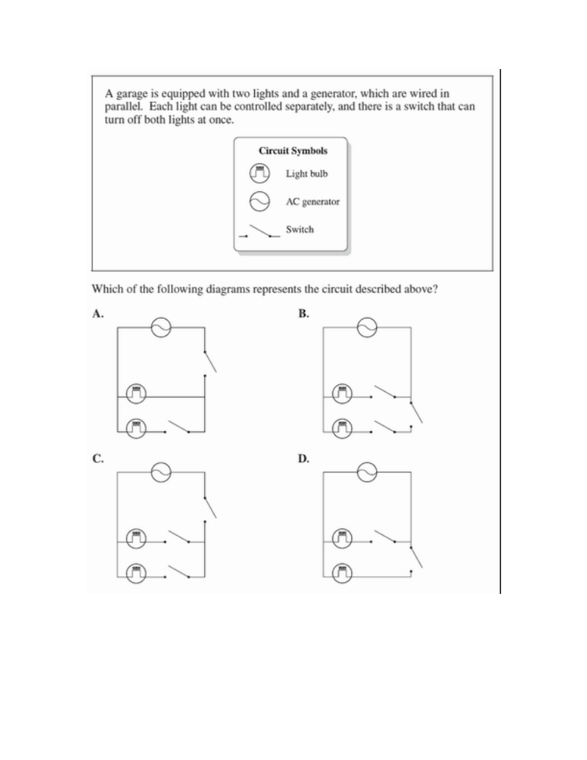

Slide 42
Space Exploration Review
Main Concepts:
- Models of the universe - geocentric vs heliocentric
- Distribution of matter & the planets - characteristics of inner vs outer planets
- Telescopes (reflecting, refracting, radio and space)
- Azimuth and Altitude
- Spectroscopy
- Triangulation
- Rocketry
- Life support in space & problems in space
- Satellites - types, function and location
- Canadian contributions

