Slide 1
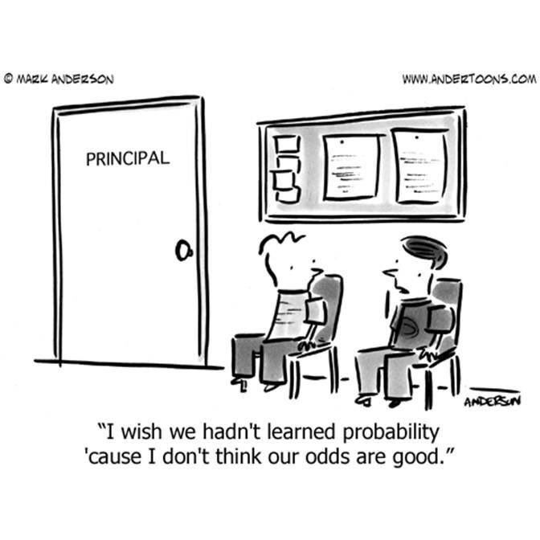
Math 9 – Unit 9
Probability and Statistics

Slide 2
Unit 9 – Probability and Statistics
Our LAST math unit (and it’s a short one)
Probably will increase….

Slide 3
Unit 9 – Probability and Statistics
Probability refers to the likelihood that an event will occur.
Flip a coin – 0.5 probability
Subjective judgment – despite probability you may feel strongly for heads/tails
Notes:
By collecting and analyzing data, predictions can be made about the likelihood that certain event will occur.

Slide 4
Unit 9 – Probability and Statistics
When we refer to probability we are usually referring to theoretical probability. It is what we EXPECT will happen.

Slide 5
Unit 9 – Probability and Statistics
Example – what is the probability of rolling a number greater than 4?
The 2 favourable outcomes are 5 and 6
There are 6 possible outcomes
Notes:
2/6 or 1/3

Slide 6
Unit 9 – Probability and Statistics
Experimental Probability – the probability of an event calculated by experimental results
Experimental and theoretical probability do not have to have the same outcomes.
If you rolled a die 60 times, based on theoretical probability you expect it to land on 5 or 6 how many times?
If you were to actually roll the dice 60 times your results may be different. Experimental probability.
Notes:
20 times, or 1/3

Slide 7
Unit 9 – Probability and Statistics
Theoretical: If you toss a coin ten times what is the probability it will land on heads?
Experimental:
Notes:
5/10 or 1/2

Slide 8
Unit 9 – Probability and Statistics
Sometime when we make a decision, we take certain things for granted. When we do this we make assumptions.

Slide 9
Unit 9 – Probability and Statistics
A health magazine claims that people who exercise 3 times per week for an hour reduce their risk of heart disease by 40%. Jaedyn plays soccer 3 times a week so she thinks she has reduced her risk of heart disease by 40%.
A – What assumptions is Jaedyn making?
B – How might the outcome change if assumptions change?

Slide 10
Unit 9 – Probability and Statistics
A – What assumptions is Jaedyn making?
Jaedyn is assuming NO other factors increase the risk of developing heart disease.
Eating habits, blood pressure, family history, exposure to smoking, age, BMI

Slide 11
Unit 9 – Probability and Statistics
B – How might the outcome change if assumptions change?
If Jaedyn eats a lot of junk food, or she lives with people who smoker her risk of developing heart disease might increase.
Notes:
If Jordyn’s family has no history of heart disease, she lives with non-smokers and she eats a healthy diet, her risk of developing heart disease might decrease.

Slide 12
Unit 9 – Probability and Statistics
Probability – the likelihood that an event will occur.
Can be written as P(event)
P(Flipping Heads) = 1/2

Slide 13
Unit 9 – Probability and Statistics
Trystyne made 32 out of 50 basketball shots attempted. What is the probability he will sink the next shot?
Write the answer as a fraction,
a decimal AND percent.

Slide 14
Unit 9 – Probability and Statistics
Trystyne made 32 out of 50 basketball shots attempted. What is the probability he will sink the next shot?
Write the answer as a fraction, a decimal AND percent.
P(sinking next shot) = 16/25 or 0.64 or 64%

Slide 15
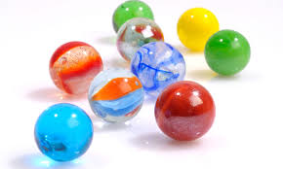
Unit 9 – Probability and Statistics
A bag contains 20 marbles. There are 15 red marbles and 5 blue. What is the theoretical probability that you will pick red?

Slide 16
Unit 9 – Probability and Statistics
A bag contains 20 marbles. There are 15 red marbles and 5 blue. What is the theoretical probability that you will pick red?
P(red) = 15/20
= ¾ or 75%

Slide 17
Unit 9 – Probability and Statistics
What is the theoretical probability of rolling a 5 on a die?
P(5) =
In an experiment, you rolled a dice 25 times and rolled a 5 five times. What is your experimental probability?
EP =
Notes:
P = 1/6 or .16666
EP = 5/25 = 1/5 = .20

Slide 18
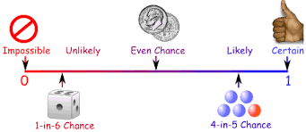
Unit 9 – Probability and Statistics
In general the higher number of trials you do, the closer the experimental probability will be to the theoretical probability.

Slide 19
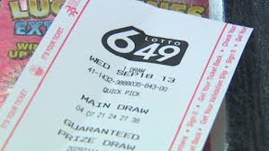
Unit 9 – Probability and Statistics
"Buying a lottery ticket today because you feel lucky", would be an example of using _________________
This means the probability is based on emotional views and a strong personal opinion. Like basing probability on a hunch or a feeling.
Notes:
subjective judgment.

Slide 20
Unit 9 – Probability and Statistics
Explain whether each decision is based on theoretical probability, experimental probability or subjective judgment.
Listening to a song you dislike on the radio because you feel the next song must be one of your favourites.
Notes:
⤷ this is based on subjective judgement because you have a hunch that the next song to be played on the radio station will be one that you like.

Slide 21
Unit 9 – Probability and Statistics
Explain whether each decision is based on theoretical probability, experimental probability or subjective judgment.
It is Talita's experience that 4 out of 5 times, the prize in the cereal box is found at the bottom of the box. So she opens the cereal from the bottom.
Notes:
⤷ Erin’s decision to open the box from the bottom to find her prize is based on past experience. This is an example of experimental probability.

Slide 22
Unit 9 – Probability and Statistics
Explain whether each decision is based on theoretical probability, experimental probability or subjective judgement.
Jack is rolling a die 8 times. So far he has rolled a "4" , 7 times in a row. He predicts the next roll will likely not be a 4 since each number has an equal chance of being rolled.
Notes:
⤷ Nathan is using theoretical probability because he knows the probability of rolling any number is 1 out of 6. Therefore, the probability of him not rolling a 4 is greater and is 5 out of 6.

Slide 23
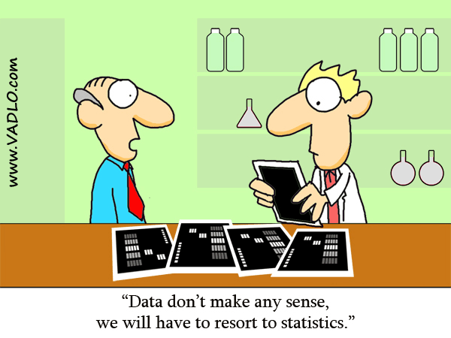
Unit 9 – Probability and Statistics
Manipulating Data
Statistics can be used to manipulate data in a way that best suits our own needs.
It can be manipulated to give
different results and
support opposing views.
Be careful when collecting
and analyzing data

Slide 24
Unit 9 – Probability and Statistics
Henry wants to learn how to snowboard but does not want to take lessons. His mother insists that Henry take lessons. They find an article that claims: "68% of snowboarding injuries occur during beginner lessons."
Explain how both Henry and his mother can use this statistic to support their own opinion.
Notes:
⤷ Quinn’s Mother can argue that the statistic proves lessons are important since beginners are prone to accidents.
⤷ Quinn can argue the statistic is a good reason not to take lessons because the likelihood of getting injured during a lesson is high.

Slide 25
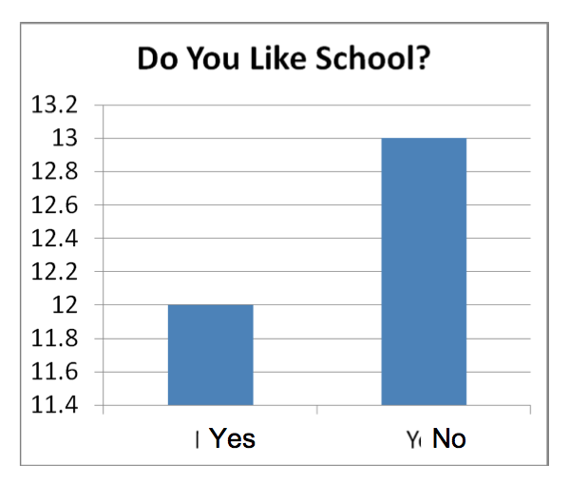
Unit 9 – Probability and Statistics
How is this graph misleading?
Notes:
⤷ the way the bars are drawn makes it look like way more people dislike school than like school.
⤷ however, if you notice the number, 25 people were asked 12 said yes and 13 said no. Therefore, it was only one more person who said they disliked school....not way more.
⤷ It’s almost 50/50. The bars should be almost the same height.

Slide 26
Unit 9 – Probability and Statistics
Potential Problems with Collecting Data:
Timing – when data are collected could affect results
Privacy – people may not want to share personal information
Cultural Sensitivity – the survey must not offend other cultures
Cost – cost of collecting data
Notes:
1. Timing - The results of a survey on ski-jackets may differ if the survey is conducted in the
summer instead of the winter.
2.Privacy - Students may not want to share their school grades.
3. Cultural Sensitivity – A question about Christmas shopping may offend those who do not celebrate Christmas.
4. Cost –the cost of mailing a survey to a large number of people may be too expensive.

Slide 27
Unit 9 – Probability and Statistics
Potential Problems with Collecting Data:
5. Time – the amount of time
6. Use of Language – leading questions
7. Bias – The question influences responses
8. Ethics – the data collected must not be used for other purposes, otherwise your actions are unethical
Notes:
5. Time A 30 minute survey conducted over the lunch period may not interest students. Most would not want to give up 30 minutes of their lunch!
6.Use of Language –This question may lead students to answer “Yes” Don’t you think the cafeteria food is too expensive?
A better wording might be....
Do you think food in the cafeteria is priced a). too low ? b). just right ? c). too high ?
7. Bias - Don't you think movie ticket prices are too high? There is already a bias against the price in the question.
8. Ethics - Surveying your class to find out their favourite snacks so you can have them available at your birthday party. But then you use the information to sell your classmates snacks between classes.

Slide 28
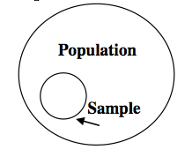
Unit 9 – Probability and Statistics
Sample vs. Population
When a census is conducted, data are collected from all people or items in the population
It is not always reasonable to census an entire population
When a population is too large
It is necessary to collect a
Representative portion of the
Population – called a sample.

Slide 29
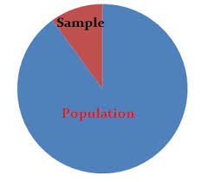
Unit 9 – Probability and Statistics
Sample should represent the population
Size of sample should be considered
Selection should be random
Notes:
The sample should represent the population. For example, the sample should contain a proportional number of girls and boys.
If the Grade 9 population of 300 students has 150 girls and 150 boys, then the sample of 50 students should have 25 girls and 25 boys.
The size of the sample should also be considered.
For example, if the sample size is too small the results may not represent the population. Ten grade 9 students may not provide valid conclusions (represent what is typical of the population).

Slide 30
Unit 9 – Probability and Statistics
Selecting a Sample
Simple Random Sampling
Each member of the population has an equal chance of being chosen.
Example: The name of each student in the class is put into a hat and 5 names are drawn.

Slide 31
Unit 9 – Probability and Statistics
Selecting a Sample
Systematic Sampling
Every n^{th} member of the population is chosen. Example: Every 10th name in the telephone directory is chosen.

Slide 32
Unit 9 – Probability and Statistics
Selecting a Sample
Cluster Sampling
The population is divided into groups and every member of one group is chosen.
Example: A school has five grade 9 classes. All students in one class are chosen.

Slide 33
Unit 9 – Probability and Statistics
Selecting a Sample
Self-Selected Sampling
Members of the population volunteer to be chosen.
Examples: 40 students volunteer to take a survey about homework habits. NTV news has a question of the week. Viewers volunteer to phone in their answer.

Slide 34
Unit 9 – Probability and Statistics
Selecting a Sample
Convenience Sampling
Members of the population who are convenient are chosen.
Example: The principal chooses the first 3 boys she sees to help her move chairs into the gym.

Slide 35
Unit 9 – Probability and Statistics
Selecting a Sample
Stratified Random Sampling
Some members of each group of the population are randomly chosen.
Example: The school’s population is divided into grades and 20 students from each grade are chosen.

Slide 36
Unit 9 – Probability and Statistics
Math Practice - Pages 458 – 460
Any 5 questions and check your answers!!!

